Slide 1
Packstack (Neutron)
보라매NOC – 가상화WG

Slide 2
목차
1. Neutron Parameter
2. osc.answer (Linuxbridge VLAN)
3. osc.answer (OVS VLAN)
4. osc.answer (OVS VXLAN)

Slide 3
사전준비
1. VMWARE CENTOS 7버젼 설치 (GUI 지원)
2. IP 설정 및 공인망 라우팅 설정
- Adapter1: NAT (OSC, 공인망)
- Adapter2: HOST-only (사설망)
- /etc/resolve.conf (NAT 인터페이스의 DNS주소로)
3. PROCESS 설정
- NetworkManager stop
- Firewalld stop
- setenforce = 0 (permissive 모드)

Slide 4
Packstack 설치
1. CentOS7 Packstack 설치
yum install -y centos-release-openstack-mitaka
yum update -y
yum install -y openstack-packstack
cd /root
packstack –-gen-answer-file=/root/answer.txt
cp answer,.txt answer_bakckup.txt
packstack –-answer-file=/root/answer.txt
※ answer파일 네트워크 설정 (싸이트 참조)
- nova network (options+vlan option) + neutron (config+ml2 plugin config + agent config)
- https://www.mankier.com/1/packstack#Options-Neutron_OVS_agent_config_for_tunnels

Slide 5
Network Config
1. Neutron config
CONFIG_NEUTRON_KS_PW
Password to use for OpenStack Networking (neutron) to authenticate with the Identity service.
CONFIG_NEUTRON_DB_PW
The password to use for OpenStack Networking to access the database.
CONFIG_NEUTRON_L3_EXT_BRIDGE
The name of the Open vSwitch bridge (or empty for linuxbridge) for the OpenStack Networking L3 agent to use for external traffic. Specify 'provider' if you intend to use a provider network to handle external traffic.
CONFIG_NEUTRON_METADATA_PW
Password for the OpenStack Networking metadata agent.
CONFIG_LBAAS_INSTALL
Specify 'y' to install OpenStack Networking's Load-Balancing-as-a-Service (LBaaS). ['y', 'n']
CONFIG_NEUTRON_METERING_AGENT_INSTALL
Specify 'y' to install OpenStack Networking's L3 Metering agent ['y', 'n']
CONFIG_NEUTRON_FWAAS
Specify 'y' to configure OpenStack Networking's Firewall-as-a-Service (FWaaS). ['y', 'n']
CONFIG_NEUTRON_VPNAAS
Specify 'y' to configure OpenStack Networking's VPN-as-a-Service (VPNaaS). ['y', 'n']

Slide 6
Network Config
2. Neutron ML2 plugin config
CONFIG_NEUTRON_ML2_TYPE_DRIVERS
Comma-separated list of network-type driver entry points to be loaded from the neutron.ml2.type_drivers namespace. ['local', 'flat', 'vlan', 'gre', 'vxlan']
CONFIG_NEUTRON_ML2_TENANT_NETWORK_TYPES
Comma-separated, ordered list of network types to allocate as tenant networks. The 'local' value is only useful for single-box testing and provides no connectivity between hosts. ['local', 'vlan', 'gre', 'vxlan']
CONFIG_NEUTRON_ML2_MECHANISM_DRIVERS
Comma-separated ordered list of networking mechanism driver entry points to be loaded from the neutron.ml2.mechanism_drivers namespace. ['logger', 'test', 'linuxbridge', 'openvswitch', 'hyperv', 'ncs', 'arista', 'cisco_nexus', 'mlnx', 'l2population', 'sriovnicswitch']
CONFIG_NEUTRON_ML2_FLAT_NETWORKS
Comma-separated list of physical_network names with which flat networks can be created. Use * to allow flat networks with arbitrary physical_network names.
CONFIG_NEUTRON_ML2_VLAN_RANGES
Comma-separated list of <physical_network>:<vlan_min>:<vlan_max> or <physical_network> specifying physical_network names usable for VLAN provider and tenant networks, as well as ranges of VLAN tags on each available for allocation to tenant networks.
CONFIG_NEUTRON_ML2_TUNNEL_ID_RANGES
Comma-separated list of <tun_min>:<tun_max> tuples enumerating ranges of GRE tunnel IDs that are available for tenant-network allocation. A tuple must be an array with tun_max +1 - tun_min > 1000000.
CONFIG_NEUTRON_ML2_VXLAN_GROUP
Comma-separated list of addresses for VXLAN multicast group. If left empty, disables VXLAN from sending allocate broadcast traffic (disables multicast VXLAN mode). Should be a Multicast IP (v4 or v6) address.
CONFIG_NEUTRON_ML2_SUPPORTED_PCI_VENDOR_DEVS
Comma separated list of supported PCI vendor devices defined by vendor_id:product_id according to the PCI ID Repository.
CONFIG_NEUTRON_ML2_VNI_RANGES
Comma-separated list of <vni_min>:<vni_max> tuples enumerating ranges of VXLAN VNI IDs that are available for tenant network allocation. Minimum value is 0 and maximum value is 16777215.
CONFIG_NEUTRON_ML2_SRIOV_AGENT_REQUIRED
Specify 'y' if the sriov agent is required
CONFIG_NEUTRON_ML2_SRIOV_INTERFACE_MAPPINGS
Comma-separated list of interface mappings for the OpenStack Networking ML2 SRIOV agent. Each tuple in the list must be in the format <physical_network>:<net_interface>. Example: physnet1:eth1,physnet2:eth2,physnet3:eth3.
CONFIG_NEUTRON_L2_AGENT
Name of the L2 agent to be used with OpenStack Networking. ['linuxbridge', 'openvswitch']

Slide 7
Network Config
3. Neutron agent config
Neutron LB agent config
CONFIG_NEUTRON_LB_INTERFACE_MAPPINGS
Comma-separated list of interface mappings for the OpenStack Networking linuxbridge plugin. Each tuple in the list must be in the format <physical_network>:<net_interface>. Example: physnet1:eth1,physnet2:eth2,physnet3:eth3.
Neutron OVS agent config
CONFIG_NEUTRON_OVS_BRIDGE_MAPPINGS
Comma-separated list of bridge mappings for the OpenStack Networking Open vSwitch plugin. Each tuple in the list must be in the format <physical_network>:<ovs_bridge>. Example: physnet1:br-eth1,physnet2:br-eth2,physnet3:br-eth3
CONFIG_NEUTRON_OVS_BRIDGE_IFACES
Comma-separated list of colon-separated Open vSwitch <bridge>:<interface> pairs. The interface will be added to the associated bridge. If you desire the bridge to be persistent a value must be added to this directive, also CONFIG_NEUTRON_OVS_BRIDGE_MAPPINGS must be set in order to create the proper port. This can be achieved from the command line by issuing the following command: packstack --allinone --os-neutron-ovs-bridge-mappings=ext-net:br-ex --os-neutron-ovs-bridge-interfaces=br-ex:eth0
Neutron OVS agent config for tunnels
CONFIG_NEUTRON_OVS_TUNNEL_IF
Interface for the Open vSwitch tunnel. Packstack overrides the IP address used for tunnels on this hypervisor to the IP found on the specified interface (for example, eth1).
Neutron OVS agent config for VXLAN
CONFIG_NEUTRON_OVS_VXLAN_UDP_PORT
VXLAN UDP port

Slide 8
2. Packstack Neutron 설정
항목 | 옵션 | 기본값 | 분류 | 설명
CONFIG_NEUTRON_L3_EXT_BRIDGE | --os-neutron-l3-ext-bridge | br-ex |  | The name of the bridge that the OpenStack Networking L3 agent will use for external traffic. Use provider if you intend to use a provider network to handle external traffic.
CONFIG_NEUTRON_L2_PLUGIN | --os-neutron-l2-plugin | openvswitch |  | The name of the L2 plugin to be used with OpenStack Networking.
CONFIG_NEUTRON_ML2_TYPE_DRIVERS | --os-neutron-ml2-type-drivers | vxlan |  | A comma separated list of network type driver entry points to be loaded from the neutron.ml2.type_drivers namespace.
CONFIG_NEUTRON_ML2_TENANT_NETWORK_TYPES | --os-neutron-ml2-tenant-network-types | vxlan |  | A comma separated ordered list of network types to allocate as tenant networks. The value local is only useful for single-box testing but provides no connectivity between hosts.
CONFIG_NEUTRON_ML2_MECHANISM_DRIVERS | --os-neutron-ml2-mechanism-drivers | openvswitch | 스위치종류 | A comma separated ordered list of networking mechanism driver entry points to be loaded from the neutron.ml2.mechanism_drivers namespace.
CONFIG_NEUTRON_ML2_FLAT_NETWORKS | --os-neutron-ml2-flat-networks | * | Flat | A comma separated list of physical_network names with which flat networks can be created. Use * to allow flat networks with arbitrary physical network names.
CONFIG_NEUTRON_ML2_VLAN_RANGES | --os-neutron-ml2-vlan-ranges |  | vlan | A comma separated list of physical_network:vlan_min:vlan_max or physical_network specifying physical_network names usable for VLAN provider and tenant networks, as well as ranges of VLAN tags on each available for allocation to tenant networks.

Slide 9
2. Neutron Parameter
항목 | 옵션 | 기본값 | 분류 | 설명
CONFIG_NEUTRON_ML2_TUNNEL_ID_RANGES | --os-neutron-ml2-tunnel-id-ranges |  | GRE | A comma separated list of tun_min:tun_max tuples enumerating ranges of GRE tunnel IDs that are available for tenant network allocation. It must be an array with tun_max +1 - tun_min > 1,000,000
CONFIG_NEUTRON_ML2_VXLAN_GROUP | --os-neutron-ml2-vxlan-group |  | Vxlan | Multicast group for VXLAN. If not set, disables VXLAN from sending allocated broadcast traffic to this multicast group. When left unconfigured, will disable multicast VXLAN mode. Must be a Multicast IP (v4 or v6) address.
CONFIG_NEUTRON_ML2_VNI_RANGES | --os-neutron-ml2-vni-ranges | n:m | Vxlan | A comma separated list of vni_min:vni_max tuples enumerating ranges of VXLAN VNI IDs that are available for tenant network allocation. Minimum value is 0 and maximum value is 16777215.
CONFIG_NEUTRON_L2_AGENT | --os-neutron-l2-agent | openvswitch | 스위치종류 | The name of the L2 agent to be used with OpenStack Networking.
CONFIG_NEUTRON_LB_TENANT_NETWORK_TYPE | --os-neutron-lb-tenant-network-type | local | Linux bridge | The type of network to allocate for tenant networks. Supported values are local and vlan. For multi-node deployments vlan is recommended.
CONFIG_NEUTRON_LB_VLAN_RANGES | --os-neutron-lb-vlan-ranges |  | Linux bridge | A comma separated list of VLAN ranges for the OpenStack Networking linuxbridge plugin. Each tuple in the list is expected to be in the format PHYSICAL:START:END. Replace PHYSICAL with the name of a physical network, replace START with the start of the VLAN range to identify with it, and replace END with the end of the VLAN range to associate with it. (For example: physnet1:1:4094,physnet2,physnet3:3000:3999)

Slide 10
2. Neutron Parameter
항목 | 옵션 | 기본값 | 분류 | 설명
CONFIG_NEUTRON_LB_INTERFACE_MAPPINGS | --os-neutron-lb-interface-mappings |  | Linux bridge | A comma separated list of interface mappings for the OpenStack Networking linuxbridge plugin. Each tuple in the list is expected to be in the format PHYSICAL:INTERFACE. Replace PHYSICAL with the name of a physical network, and replace INTERFACE with the name of the network interface that will be used to connect to the physical network
CONFIG_NEUTRON_OVS_TENANT_NETWORK_TYPE | --os-neutron-ovs-tenant-network-type | vxlan | OVS-VXLAN | The type of network to allocate for tenant networks. Supported values are vlan, local, gre, vxlan.
CONFIG_NEUTRON_OVS_VLAN_RANGES | --os-neutron-ovs-vlan-ranges |  | OVS-VLAN | A comma separated list of VLAN ranges for the OpenStack Networking openvswitch plugin. Each tuple in the list is expected to be in the format PHYSICAL:START:END. Replace PHYSICAL with the name of a physical network, replace START with the start of the VLAN range to identify with it, and replace END with the end of the VLAN range to associate with it. (For example physnet1:1:4094,physnet2,physnet3:3000:3999)
CONFIG_NEUTRON_OVS_BRIDGE_MAPPINGS | --os-neutron-ovs-bridge-mappings | physnet1:br-eth1 | OVS | A comma separated list of bridge mappings for the OpenStack Networking openvswitch plugin. Each tuple in the list is expected to be in the format PHYSICAL:BRIDGE. Replace PHYSICAL with the name of a physical network, and replace BRIDGE with the name of the Open vSwitch bridge that will be used to connect to the physical network. (For example physnet1:br-eth1,physnet2:br-eth2,physnet3:br-eth3)

Slide 11
2. Neutron Parameter
항목 | 옵션 | 기본값 | 분류 | 설명
CONFIG_NEUTRON_OVS_BRIDGE_IFACES | --os-neutron-ovs-bridge-interfaces |  | OVS-FLAT/VLAN | A comma separated list of colon-separated OVS bridge:interface pairs. The interface will be added to the associated bridge.
CONFIG_NEUTRON_OVS_TUNNEL_RANGES | --os-neutron-ovs-tunnel-ranges |  | OVS-GRE | A comma separated list of tunnel ranges for the Neutron openvswitch plugin
CONFIG_NEUTRON_OVS_TUNNEL_IF | --os-neutron-ovs-tunnel-if |  | OVS-GRE/VXLAN | The interface for the OVS tunnel. Packstack will override the IP address used for tunnels on this hypervisor to the IP found on the specified interface. (eg. eth1).
CONFIG_NEUTRON_OVS_VXLAN_UDP_PORT | --os-neutron-ovs-vxlan-udp-port | 4789 | OVS-VXLAN | The vxlan UDP port.

Slide 12
3-1. osc.answer (Linuxbridge VLAN)
# A comma separated list of network type driver entrypoints to be
# loaded from the neutron.ml2.type_drivers namespace.
CONFIG_NEUTRON_ML2_TYPE_DRIVERS=flat,vlan
# A comma separated ordered list of network_types to allocate as
# tenant networks. The value 'local' is only useful for single-box
# testing but provides no connectivity between hosts.
CONFIG_NEUTRON_ML2_TENANT_NETWORK_TYPES=vlan
# A comma separated ordered list of networking mechanism driver
# entrypoints to be loaded from the neutron.ml2.mechanism_drivers
# namespace.
CONFIG_NEUTRON_ML2_MECHANISM_DRIVERS=linuxbridge
# A comma separated list of physical_network names with which flat
# networks can be created. Use * to allow flat networks with arbitrary
# physical_network names.
CONFIG_NEUTRON_ML2_FLAT_NETWORKS=*
# A comma separated list of <physical_network>:<vlan_min>:<vlan_max>
# or <physical_network> specifying physical_network names usable for
# VLAN provider and tenant networks, as well as ranges of VLAN tags on
# each available for allocation to tenant networks.
CONFIG_NEUTRON_ML2_VLAN_RANGES=physnet1:101:112,physnet2
# A comma separated list of <tun_min>:<tun_max> tuples enumerating
# ranges of GRE tunnel IDs that are available for tenant network
# allocation. Should be an array with tun_max +1 - tun_min > 1000000
CONFIG_NEUTRON_ML2_TUNNEL_ID_RANGES=
# Multicast group for VXLAN. If unset, disables VXLAN enable sending
# allocate broadcast traffic to this multicast group. When left
# unconfigured, will disable multicast VXLAN mode. Should be an
# Multicast IP (v4 or v6) address.
CONFIG_NEUTRON_ML2_VXLAN_GROUP=
# A comma separated list of <vni_min>:<vni_max> tuples enumerating
# ranges of VXLAN VNI IDs that are available for tenant network
# allocation. Min value is 0 and Max value is 16777215.
CONFIG_NEUTRON_ML2_VNI_RANGES=10:100
# The name of the L2 agent to be used with Neutron
CONFIG_NEUTRON_L2_AGENT=linuxbridge
# A comma separated list of interface mappings for the Neutron
# linuxbridge plugin (eg. physnet1:eth1,physnet2:eth2,physnet3:eth3)
CONFIG_NEUTRON_LB_INTERFACE_MAPPINGS=physnet1:bond0,physnet2:bond2
# A comma separated list of bridge mappings for the Neutron
# openvswitch plugin (eg. physnet1:br-eth1,physnet2:br-eth2,physnet3
# :br-eth3)
CONFIG_NEUTRON_OVS_BRIDGE_MAPPINGS=
# A comma separated list of colon-separated OVS bridge:interface
# pairs. The interface will be added to the associated bridge.
CONFIG_NEUTRON_OVS_BRIDGE_IFACES=
# The interface for the OVS tunnel. Packstack will override the IP
# address used for tunnels on this hypervisor to the IP found on the
# specified interface. (eg. eth1)
CONFIG_NEUTRON_OVS_TUNNEL_IF=
# VXLAN UDP port
CONFIG_NEUTRON_OVS_VXLAN_UDP_PORT=4789

Slide 13
3-1. osc.answer (Linuxbridge VLAN)
1. controller/compute Network 구조
qhdcp-namespace1
dnsqmasq1
qhdcp-namespace2
dnsqmasq2
instance 01
ns-e4d54a6e-19
ns-d56d9236-17
eth0
eth1
tabbd235bf4-08
tabe840a131-6d
tabbd235bf4-08
tabe840a131-6d
Linux bridge
Linux bridge
Linux bridge
Linux bridge
ens160
ens192
ens224
ens160
ens192
ens224

Slide 14
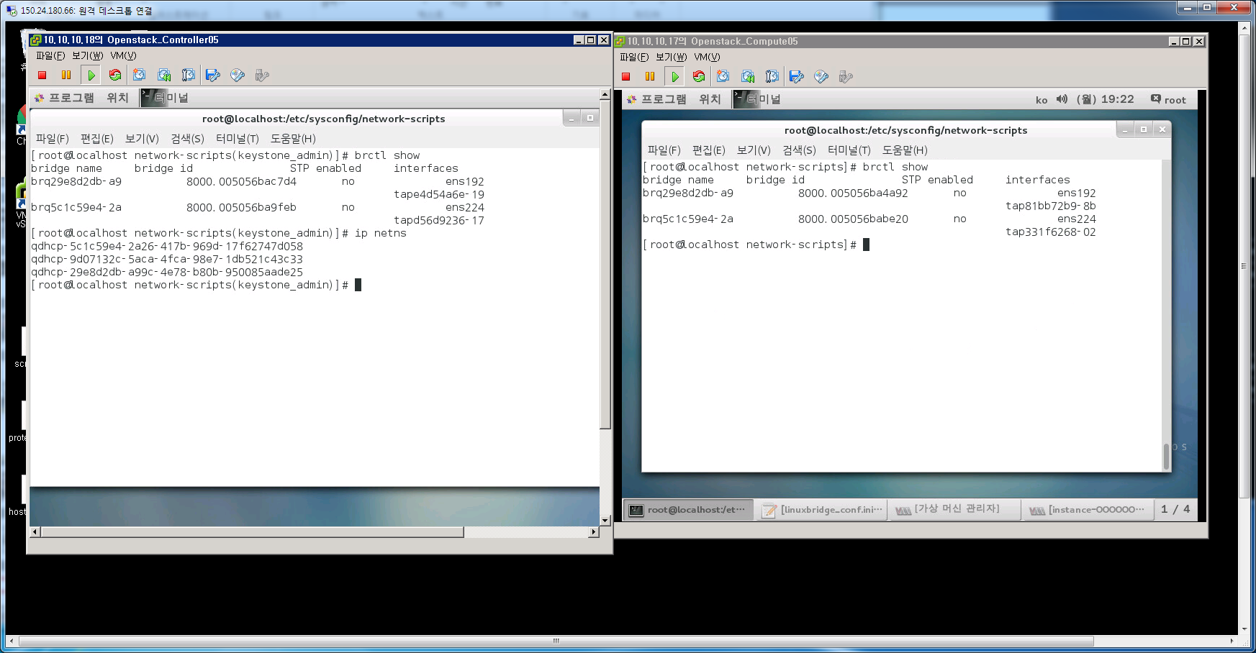
3-1. osc.answer (Linuxbridge VLAN)
1. controller/compute Network 구조
NETWORK 구조변경시
OVS 인터페이스 설정작업 (Controller, Compute)
ml2 config, bridge (linux, ovs) config 설정
리부팅
인스턴스 생성

Slide 15
3-2. osc.answer (OVS VLAN)
# A comma separated list of network type driver entrypoints to be
# loaded from the neutron.ml2.type_drivers namespace.
CONFIG_NEUTRON_ML2_TYPE_DRIVERS=flat,vlan
# A comma separated ordered list of network_types to allocate as
# tenant networks. The value 'local' is only useful for single-box
# testing but provides no connectivity between hosts.
CONFIG_NEUTRON_ML2_TENANT_NETWORK_TYPES=vlan
# A comma separated ordered list of networking mechanism driver
# entrypoints to be loaded from the neutron.ml2.mechanism_drivers
# namespace.
CONFIG_NEUTRON_ML2_MECHANISM_DRIVERS=openvswitch
# A comma separated list of physical_network names with which flat
# networks can be created. Use * to allow flat networks with arbitrary
# physical_network names.
CONFIG_NEUTRON_ML2_FLAT_NETWORKS=*
# A comma separated list of <physical_network>:<vlan_min>:<vlan_max>
# or <physical_network> specifying physical_network names usable for
# VLAN provider and tenant networks, as well as ranges of VLAN tags on
# each available for allocation to tenant networks.
CONFIG_NEUTRON_ML2_VLAN_RANGES=physnet1:10:20,physnet2
# A comma separated list of <tun_min>:<tun_max> tuples enumerating
# ranges of GRE tunnel IDs that are available for tenant network
# allocation. Should be an array with tun_max +1 - tun_min > 1000000
CONFIG_NEUTRON_ML2_TUNNEL_ID_RANGES=
# Multicast group for VXLAN. If unset, disables VXLAN enable sending
# allocate broadcast traffic to this multicast group. When left
# unconfigured, will disable multicast VXLAN mode. Should be an
# Multicast IP (v4 or v6) address.
CONFIG_NEUTRON_ML2_VXLAN_GROUP=
# A comma separated list of <vni_min>:<vni_max> tuples enumerating
# ranges of VXLAN VNI IDs that are available for tenant network
# allocation. Min value is 0 and Max value is 16777215.
CONFIG_NEUTRON_ML2_VNI_RANGES=10:100
# The name of the L2 agent to be used with Neutron
CONFIG_NEUTRON_L2_AGENT=openvswitch
# A comma separated list of interface mappings for the Neutron
# linuxbridge plugin (eg. physnet1:eth1,physnet2:eth2,physnet3:eth3)
CONFIG_NEUTRON_LB_INTERFACE_MAPPINGS=
# A comma separated list of bridge mappings for the Neutron
# openvswitch plugin (eg. physnet1:br-eth1,physnet2:br-eth2,physnet3
# :br-eth3)
CONFIG_NEUTRON_OVS_BRIDGE_MAPPINGS=physnet1:br-ens192, physnet2:br-ens224
# A comma separated list of colon-separated OVS bridge:interface
# pairs. The interface will be added to the associated bridge.
CONFIG_NEUTRON_OVS_BRIDGE_IFACES=br-ens192:ens192, br-ens224:ens224
# The interface for the OVS tunnel. Packstack will override the IP
# address used for tunnels on this hypervisor to the IP found on the
# specified interface. (eg. eth1)
CONFIG_NEUTRON_OVS_TUNNEL_IF=
# VXLAN UDP port
CONFIG_NEUTRON_OVS_VXLAN_UDP_PORT=4789
※ br-ens192,ens192에 대해서는 수동으로 bridge 설정필요

Slide 16
3-2. osc.answer (OVS VLAN)
1. controller/compute Network 구조
instance 01
eth0
eth1
qhdcp-namespace1
dnsqmasq1
(process)
qhdcp-namespace1
dnsqmasq2
(process)
tabbd235bf4-08
tapba198b38-fe
qbrbd235bf4-08
qbrba198b38-fe
tape4d54a6e-19
tapd56d9236-17
qvbbd235bf4-08
qvbbd235bf4-08
안으로 들어가는 vlan변환
ovs-ofctl dump-flows
br-int
tag=1 (vlan)
tag=2 (vlan)
tag=1 (vlan)
tag=2 (vlan)
qvobd235bf4-08
qvoba198b38-fe
br-int
br-int
type:patch
type:patch
밖으로 나가는vlan변환
ovs-ofctl dump-flows br-ens192
br-ens192
br-ens224
br-ens192
br-ens224
ens160
ens192
ens224
ens160
ens192
ens224

Slide 17
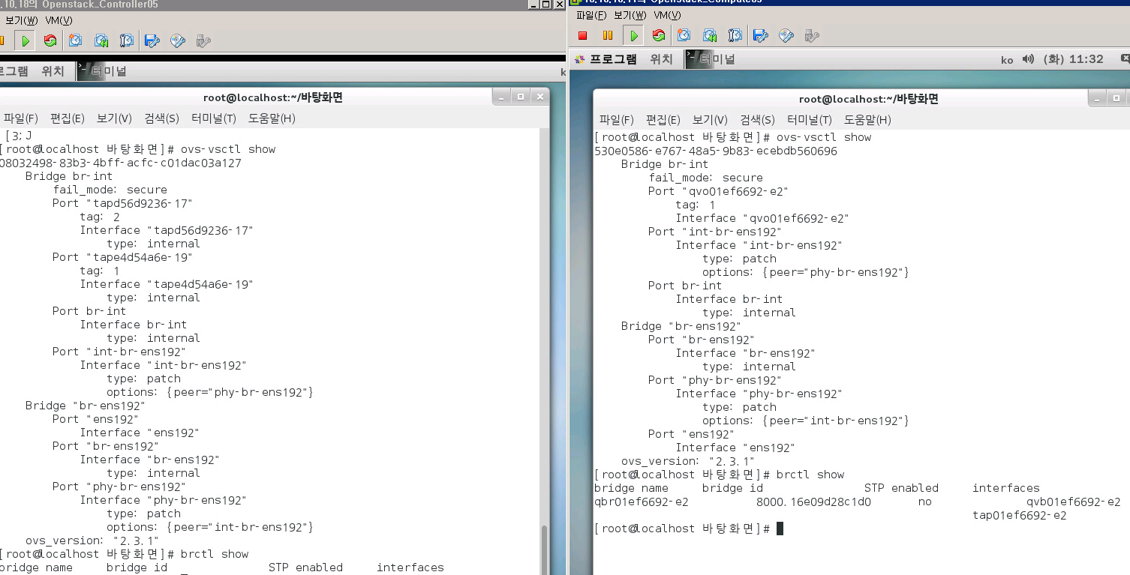
3-2. osc.answer (OVS VLAN)
1. controller/compute Network 구조

Slide 18
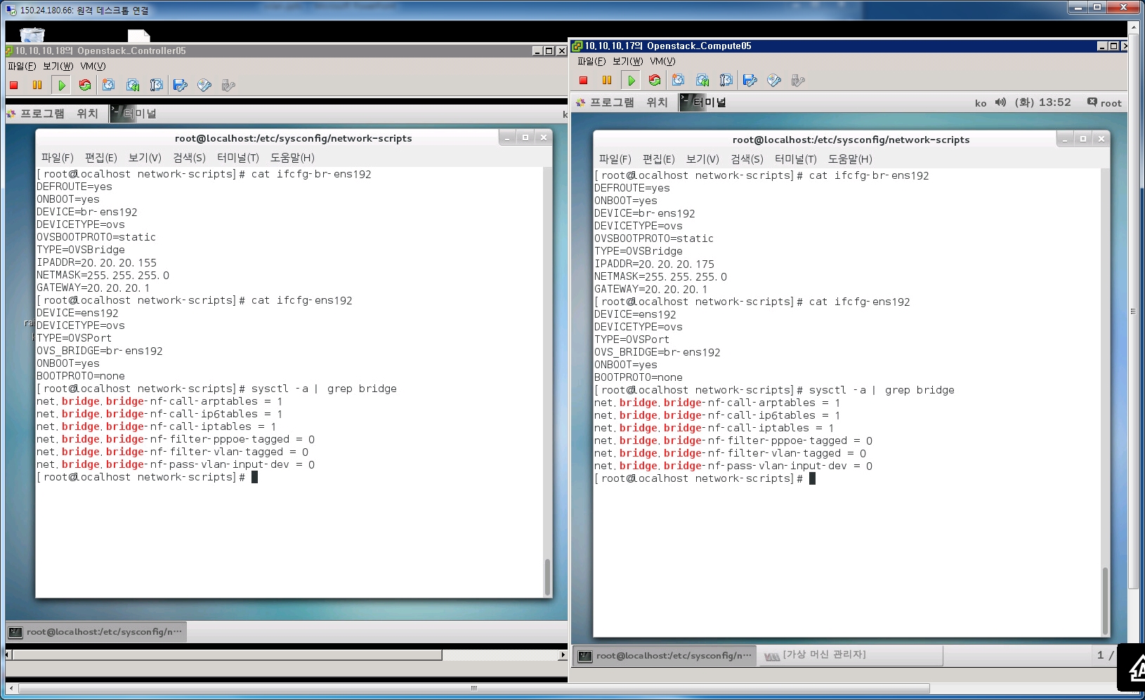
3-2. osc.answer (OVS VLAN)
1. controller/compute host 인터페이스 설정
※ iptables –L 로 확인하면 설정값이 자동으로 들어가 있음

Slide 19
3-3. osc.answer (OVS VXLAN) -default
# A comma separated list of network type driver entrypoints to be
# loaded from the neutron.ml2.type_drivers namespace.
CONFIG_NEUTRON_ML2_TYPE_DRIVERS=vxlan
# A comma separated ordered list of network_types to allocate as
# tenant networks. The value 'local' is only useful for single-box
# testing but provides no connectivity between hosts.
CONFIG_NEUTRON_ML2_TENANT_NETWORK_TYPES=vxlan
# A comma separated ordered list of networking mechanism driver
# entrypoints to be loaded from the neutron.ml2.mechanism_drivers
# namespace.
CONFIG_NEUTRON_ML2_MECHANISM_DRIVERS=openvswitch
# A comma separated list of physical_network names with which flat
# networks can be created. Use * to allow flat networks with arbitrary
# physical_network names.
CONFIG_NEUTRON_ML2_FLAT_NETWORKS=*
# A comma separated list of <physical_network>:<vlan_min>:<vlan_max>
# or <physical_network> specifying physical_network names usable for
# VLAN provider and tenant networks, as well as ranges of VLAN tags on
# each available for allocation to tenant networks.
CONFIG_NEUTRON_ML2_VLAN_RANGES=
# A comma separated list of <tun_min>:<tun_max> tuples enumerating
# ranges of GRE tunnel IDs that are available for tenant network
# allocation. Should be an array with tun_max +1 - tun_min > 1000000
CONFIG_NEUTRON_ML2_TUNNEL_ID_RANGES=
# Multicast group for VXLAN. If unset, disables VXLAN enable sending
# allocate broadcast traffic to this multicast group. When left
# unconfigured, will disable multicast VXLAN mode. Should be an
# Multicast IP (v4 or v6) address.
CONFIG_NEUTRON_ML2_VXLAN_GROUP=239.1.1.2
# A comma separated list of <vni_min>:<vni_max> tuples enumerating
# ranges of VXLAN VNI IDs that are available for tenant network
# allocation. Min value is 0 and Max value is 16777215.
CONFIG_NEUTRON_ML2_VNI_RANGES=10:100
# The name of the L2 agent to be used with Neutron
CONFIG_NEUTRON_L2_AGENT=openswitch
# A comma separated list of interface mappings for the Neutron
# linuxbridge plugin (eg. physnet1:eth1,physnet2:eth2,physnet3:eth3)
CONFIG_NEUTRON_LB_INTERFACE_MAPPINGS=
# A comma separated list of bridge mappings for the Neutron
# openvswitch plugin (eg. physnet1:br-eth1,physnet2:br-eth2,physnet3
# :br-eth3)
CONFIG_NEUTRON_OVS_BRIDGE_MAPPINGS=
# A comma separated list of colon-separated OVS bridge:interface
# pairs. The interface will be added to the associated bridge.
CONFIG_NEUTRON_OVS_BRIDGE_IFACES=
# The interface for the OVS tunnel. Packstack will override the IP
# address used for tunnels on this hypervisor to the IP found on the
# specified interface. (eg. eth1)
CONFIG_NEUTRON_OVS_TUNNEL_IF=ens192
# VXLAN UDP port
CONFIG_NEUTRON_OVS_VXLAN_UDP_PORT=4789

Slide 20
3-3. osc.answer (OVS VXLAN)
1. controller/compute Network 구조
instance 01
eth0
eth1
qhdcp-namespace1
dnsqmasq1
(process)
qhdcp-namespace1
dnsqmasq2
(process)
tabbd235bf4-08
tapba198b38-fe
qbrbd235bf4-08
qbrba198b38-fe
tape4d54a6e-19
tapd56d9236-17
qvbbd235bf4-08
qvbbd235bf4-08
tag=1 (vlan)
tag=2 (vlan)
tag=1 (vlan)
tag=2 (vlan)
qvobd235bf4-08
qvoba198b38-fe
br-int
br-int
type:patch
type:patch
br-tun
br-tun
br-tun192
br-tun
ens160
ens192
(20.20.20.165)
ens224
(30.30.30.165)
ens160
ens192
(20.20.20.185)
ens224
(30.30.30.185)
vxlan
vxlan

Slide 21
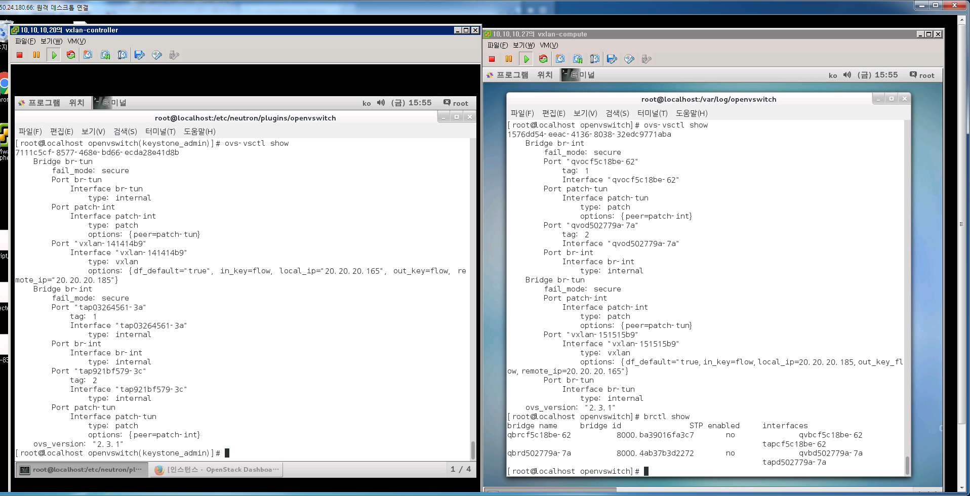
3-3. osc.answer (OVS VXLAN)
1. controller/compute Network 구조
※ compute에 vxlan port는 명령어 생성필요
ovs-vsctl add-port br-tun vxlan-1515 -- set interface vxlan-1515 type=vxlan options=df_default=“true”,in_key=flow,local_ip=“30.30.30.176”,out_key=flow,remote_ip=“30.30.30.156”

Slide 22
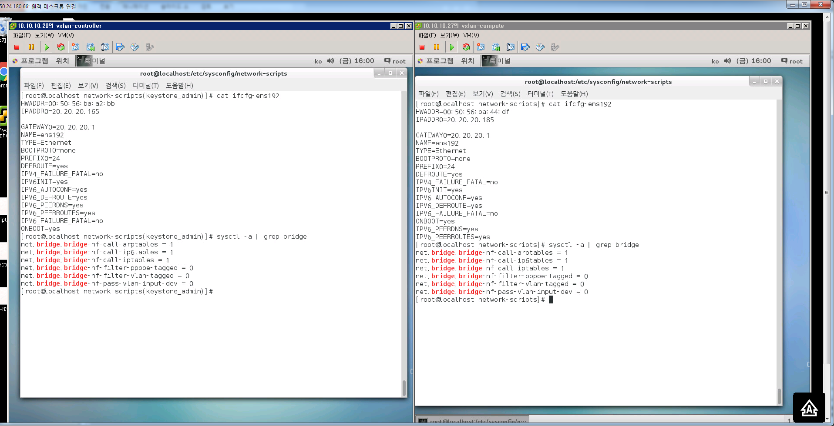
3-3. osc.answer (OVS VXLAN)
1. controller/ compute host 인터페이스 설정
※ iptables –L 로 확인하면 설정값이 자동으로 들어가 있음
※ /etc/neutron/plugins/openvswitch/ovs_neutron_plugin.ini파일에
integration_bridge=br-int
tunnel_bridge=br-tun
local_ip= 20.20.20.165
tunnel_types=vxlan

Slide 23
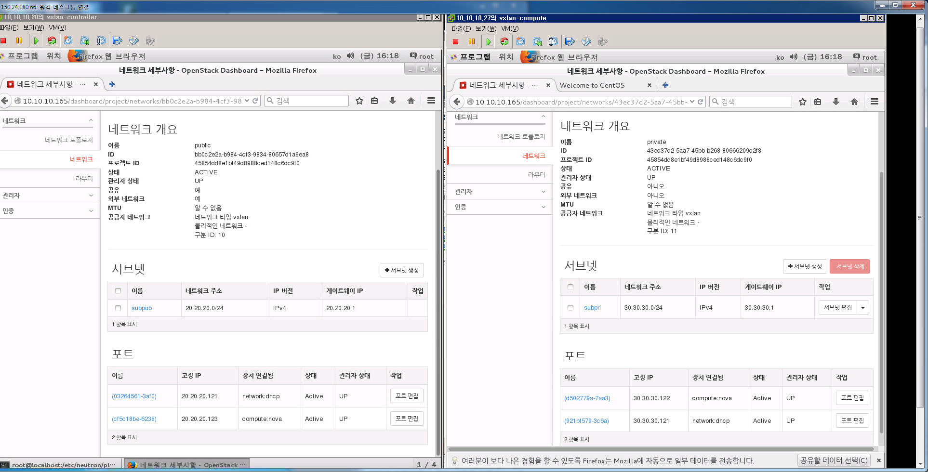
3-3. osc.answer (OVS VXLAN)
1. controller/compute host 인터페이스 설정
1. VXLAN의 VNI를 명시
2. ovs-vsctl show로 보았을때 tag 번호와 1:1 매칭
3. 네트워크별로 생성됨
4. tag 4095의 목적?

Slide 24
4. osc.answer (OVS VLAN+Router)= VLAN과 동일하게 만든후 Router 추가
# A comma separated list of network type driver entrypoints to be
# loaded from the neutron.ml2.type_drivers namespace.
CONFIG_NEUTRON_ML2_TYPE_DRIVERS=flat,vlan
# A comma separated ordered list of network_types to allocate as
# tenant networks. The value 'local' is only useful for single-box
# testing but provides no connectivity between hosts.
CONFIG_NEUTRON_ML2_TENANT_NETWORK_TYPES=vlan
# A comma separated ordered list of networking mechanism driver
# entrypoints to be loaded from the neutron.ml2.mechanism_drivers
# namespace.
CONFIG_NEUTRON_ML2_MECHANISM_DRIVERS=openvswitch
# A comma separated list of physical_network names with which flat
# networks can be created. Use * to allow flat networks with arbitrary
# physical_network names.
CONFIG_NEUTRON_ML2_FLAT_NETWORKS=*
# A comma separated list of <physical_network>:<vlan_min>:<vlan_max>
# or <physical_network> specifying physical_network names usable for
# VLAN provider and tenant networks, as well as ranges of VLAN tags on
# each available for allocation to tenant networks.
CONFIG_NEUTRON_ML2_VLAN_RANGES=physnet1:10:20,physnet2
# A comma separated list of <tun_min>:<tun_max> tuples enumerating
# ranges of GRE tunnel IDs that are available for tenant network
# allocation. Should be an array with tun_max +1 - tun_min > 1000000
CONFIG_NEUTRON_ML2_TUNNEL_ID_RANGES=
# Multicast group for VXLAN. If unset, disables VXLAN enable sending
# allocate broadcast traffic to this multicast group. When left
# unconfigured, will disable multicast VXLAN mode. Should be an
# Multicast IP (v4 or v6) address.
CONFIG_NEUTRON_ML2_VXLAN_GROUP=
# A comma separated list of <vni_min>:<vni_max> tuples enumerating
# ranges of VXLAN VNI IDs that are available for tenant network
# allocation. Min value is 0 and Max value is 16777215.
CONFIG_NEUTRON_ML2_VNI_RANGES=10:100
# The name of the L2 agent to be used with Neutron
CONFIG_NEUTRON_L2_AGENT=openvswitch
# A comma separated list of interface mappings for the Neutron
# linuxbridge plugin (eg. physnet1:eth1,physnet2:eth2,physnet3:eth3)
CONFIG_NEUTRON_LB_INTERFACE_MAPPINGS=
# A comma separated list of bridge mappings for the Neutron
# openvswitch plugin (eg. physnet1:br-eth1,physnet2:br-eth2,physnet3
# :br-eth3)
CONFIG_NEUTRON_OVS_BRIDGE_MAPPINGS=physnet1:br-ens192, physnet2:br-ens224
# A comma separated list of colon-separated OVS bridge:interface
# pairs. The interface will be added to the associated bridge.
CONFIG_NEUTRON_OVS_BRIDGE_IFACES=br-ens192:ens192, br-ens224:ens224
# The interface for the OVS tunnel. Packstack will override the IP
# address used for tunnels on this hypervisor to the IP found on the
# specified interface. (eg. eth1)
CONFIG_NEUTRON_OVS_TUNNEL_IF=
# VXLAN UDP port
CONFIG_NEUTRON_OVS_VXLAN_UDP_PORT=4789
※ br-ens192,ens192에 대해서는 수동으로 bridge 설정필요

Slide 25
4. osc.answer (OVS VLAN+Router)
1. controller/compute Network 구조
서로 다른대역끼리 ping되는지 확인
qrouter-namespace1
router
(process)
instance 01
instance 02
qg-db7233ff-c5
20.20.20.74
qr-4b6a0576-b9
30.30.30.74
eth0
(20.20.20.x)
eth0
(30.30.30.x)
qhdcp-namespace1
dnsqmasq1
(process)
qhdcp-namespace1
dnsqmasq2
(process)
tabbd235bf4-08
tapba198b38-fe
qbrbd235bf4-08
qbrba198b38-fe
tape4d54a6e-19
tapd56d9236-17
qvbbd235bf4-08
qvbbd235bf4-08
tag=1 (vlan)
tag=2 (vlan)
tag=1 (vlan)
tag=2 (vlan)
tag=1 (vlan)
tag=2 (vlan)
qvobd235bf4-08
qvoba198b38-fe
br-int
br-int
type:patch
type:patch
br-ens192
br-ens224
br-ens192
br-ens224
ens160
ens192
ens224
ens160
ens192
ens224

Slide 26
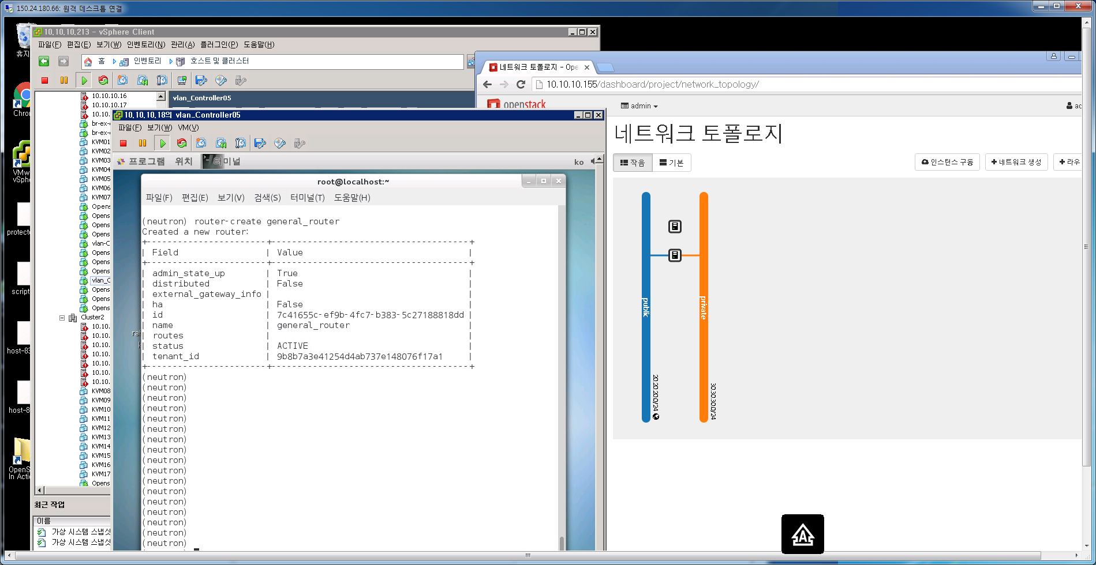
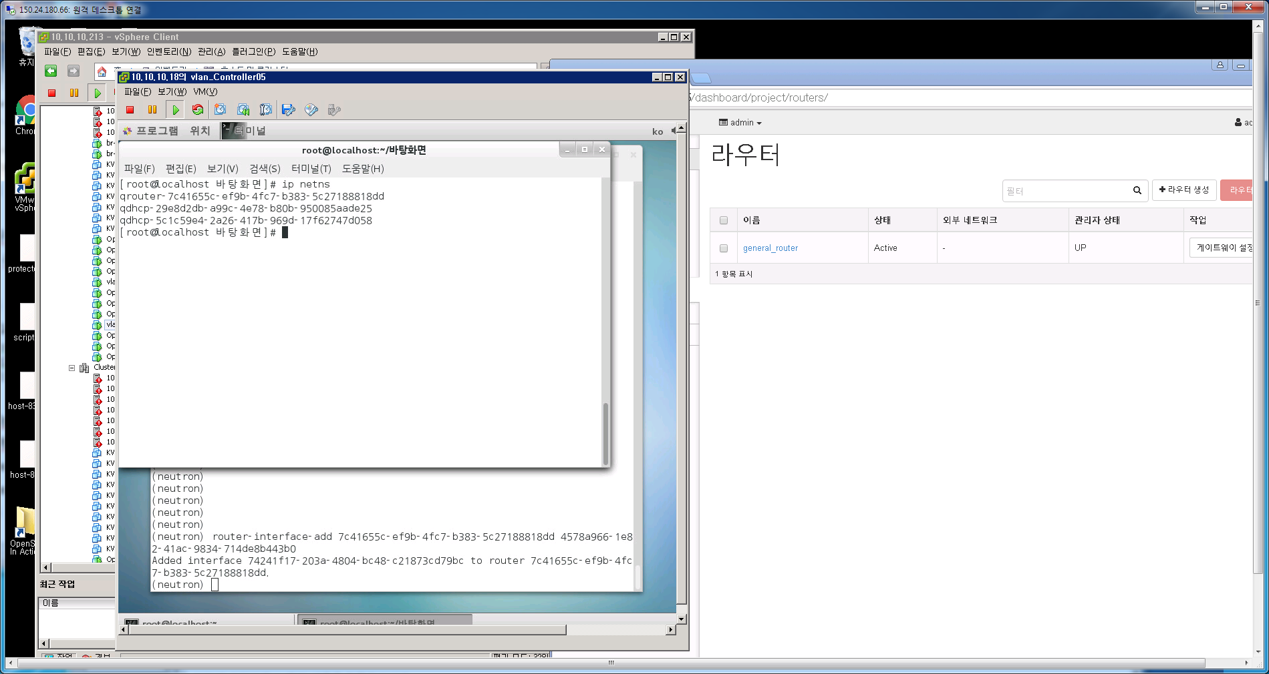
4. Router 생성절차
1. router-create 생성
1. ip netns 생성확인

Slide 27
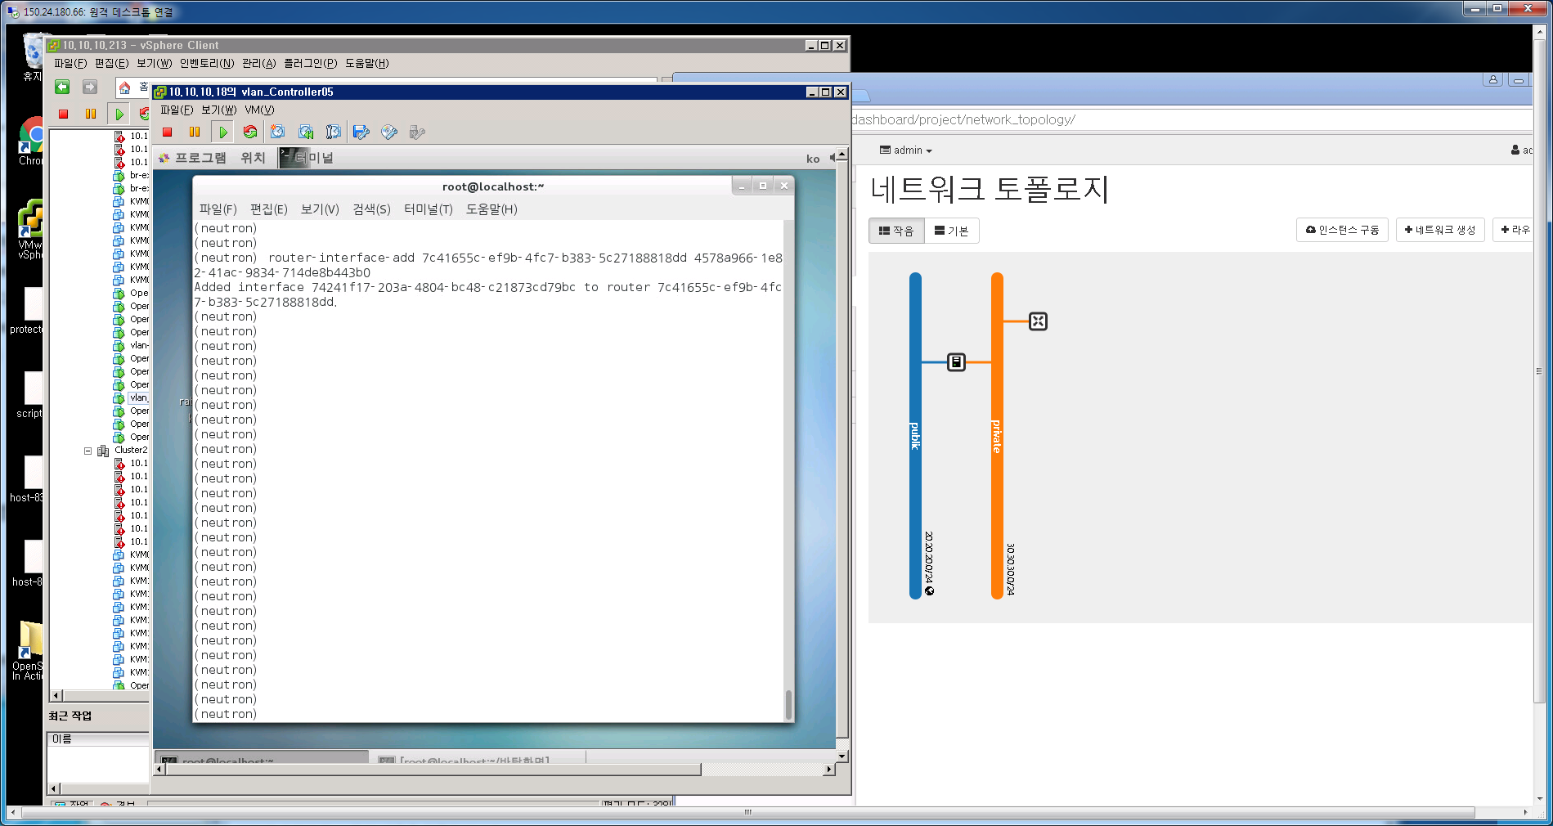
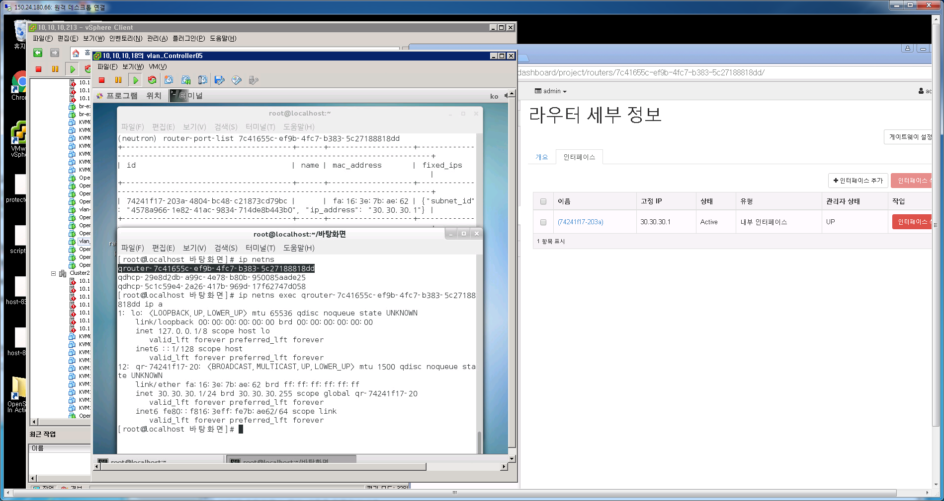
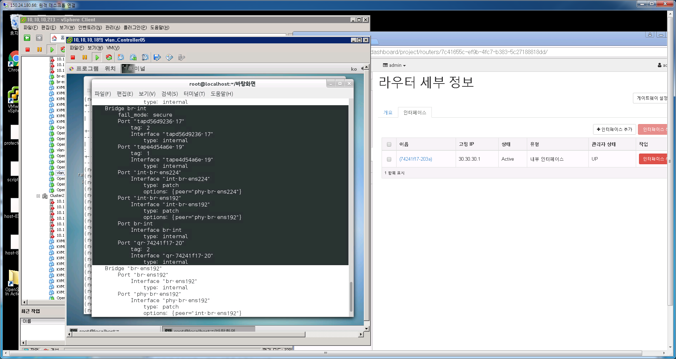
4. Router 생성절차
1. router interface를 private 네트워크에 추가
router-interface-add router-id private-subnet-id
1. router port 추가확인

Slide 28
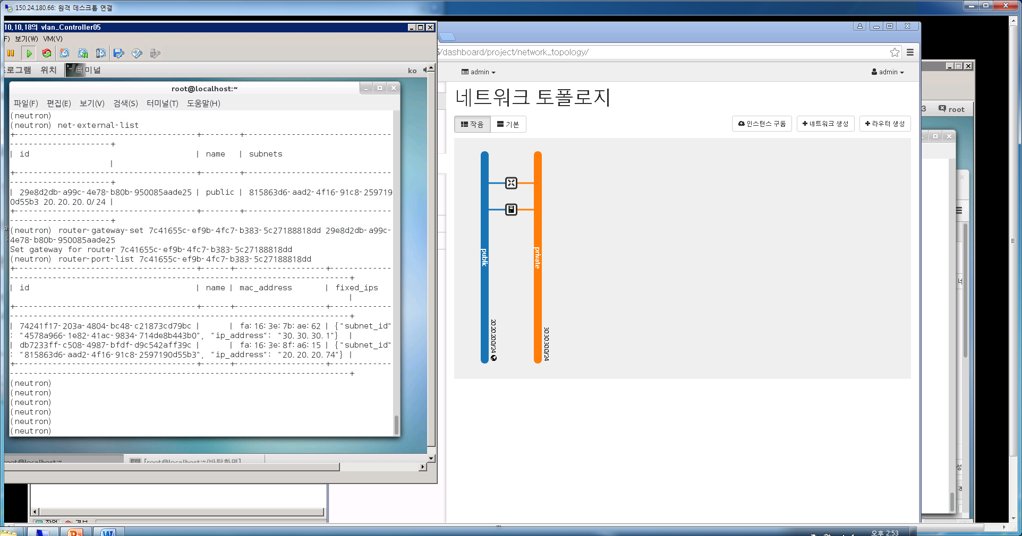
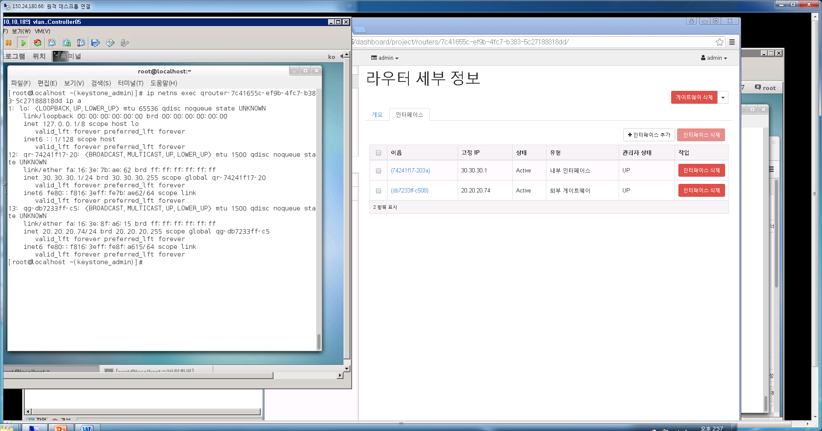
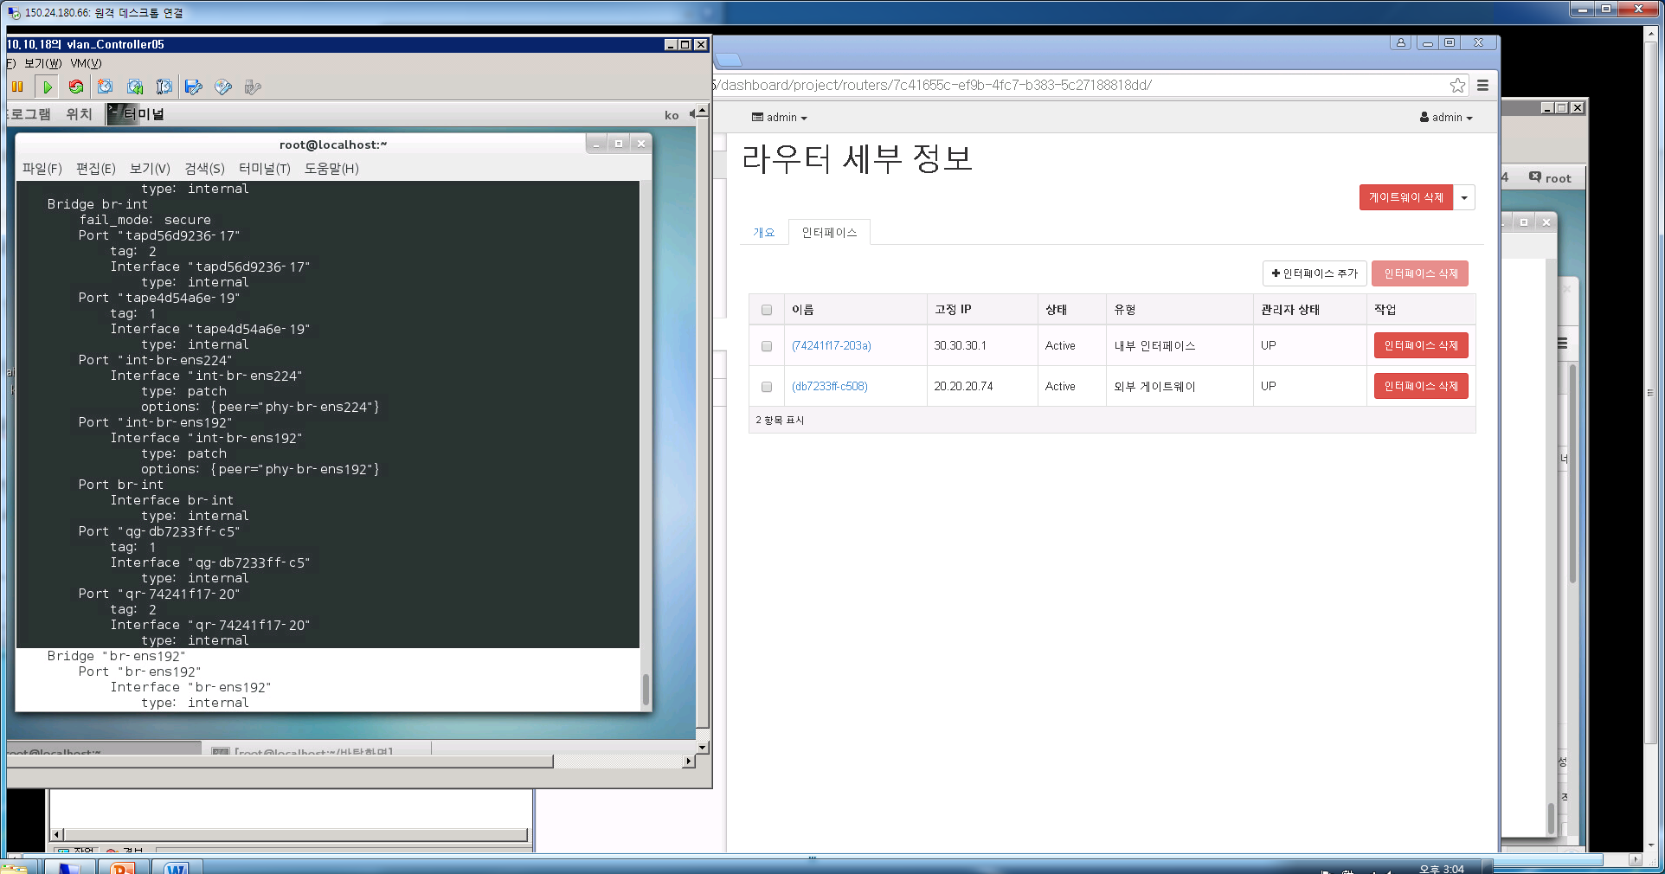
4. Router 생성절차
1. router gateway를 public 네트워크에 추가
router-gateway-set router-id public-net-id
1. router port 추가확인

Slide 29
5. osc.answer (OVS ALLINONE)
1. controller/compute Network 구조
instance 01
eth0
(192.168.101.5)
dnsqmasq1(process)
qhdcp-namespace1
tabbd235bf4-08
qbrbd235bf4-08
tape4d54a6e-19
192.168.101.2
qvbbd235bf4-08
tag=1 (vlan)
qr-4b6a0576-b9
192.168.101.1
qvobd235bf4-08
br-tun
br-int
router (process)
defatult gateway인
qg로 라우팅됨
qrouter-namespace1
type:patch
br-ex
(192.168.17.160)
qg-32e3a496-94
192.168.17.11
eno16777736
외부네트워크
(192.168.17.2)

Slide 30
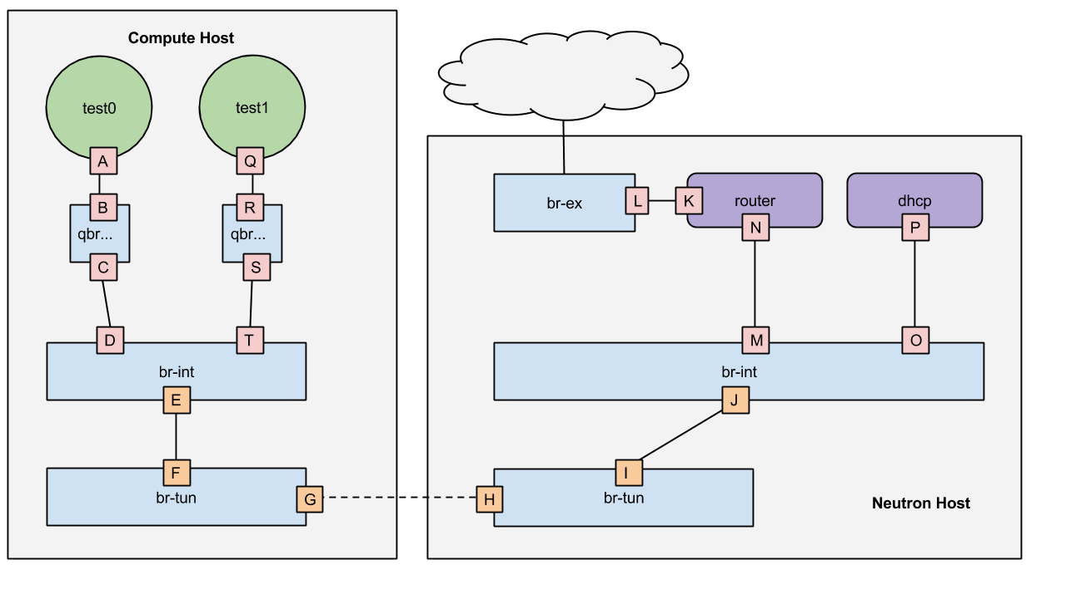
5. osc.answer (VXLAN 2node 구조)
1. VXLAN 2node 구조 구간별 설명
https://www.rdoproject.org/networking/networking-in-too-much-detail/

Slide 31
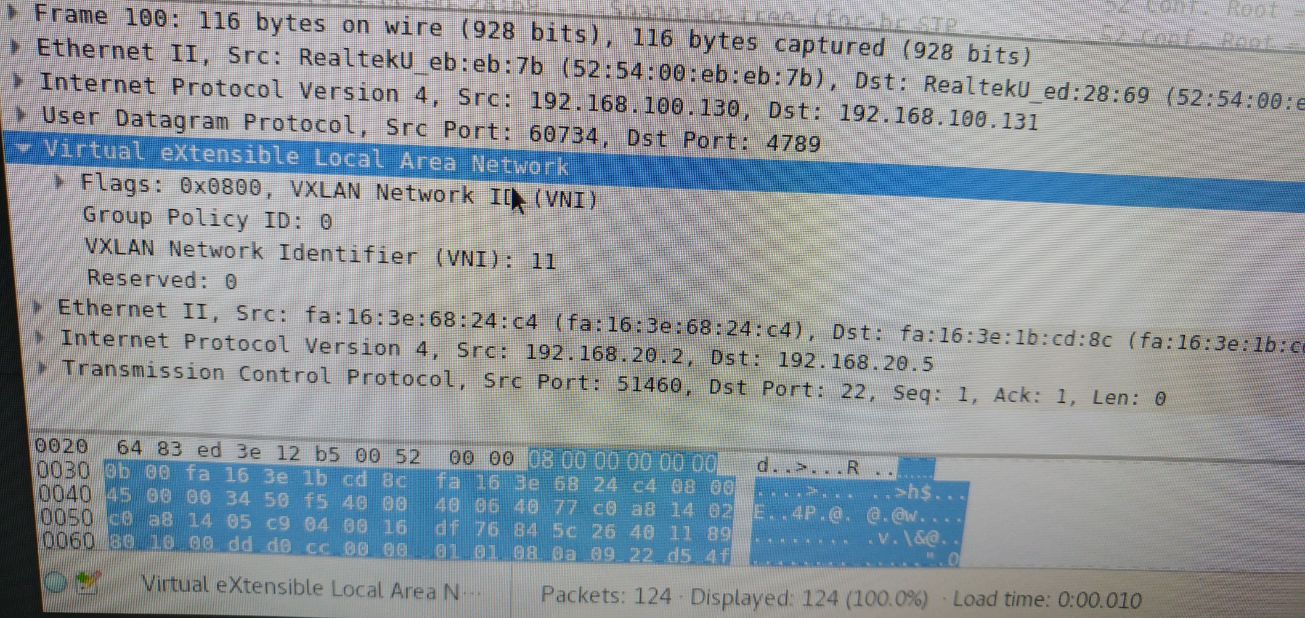
5. osc.answer (VXLAN 패킷캡쳐)
1. VXLAN 패킷구조
L1
L2
L3
L4
VXLAN
L2
L3
L4
OUTTER 구간 (VTEP~VTEP)
INNER 구간 (INSTANCE)

Slide 32
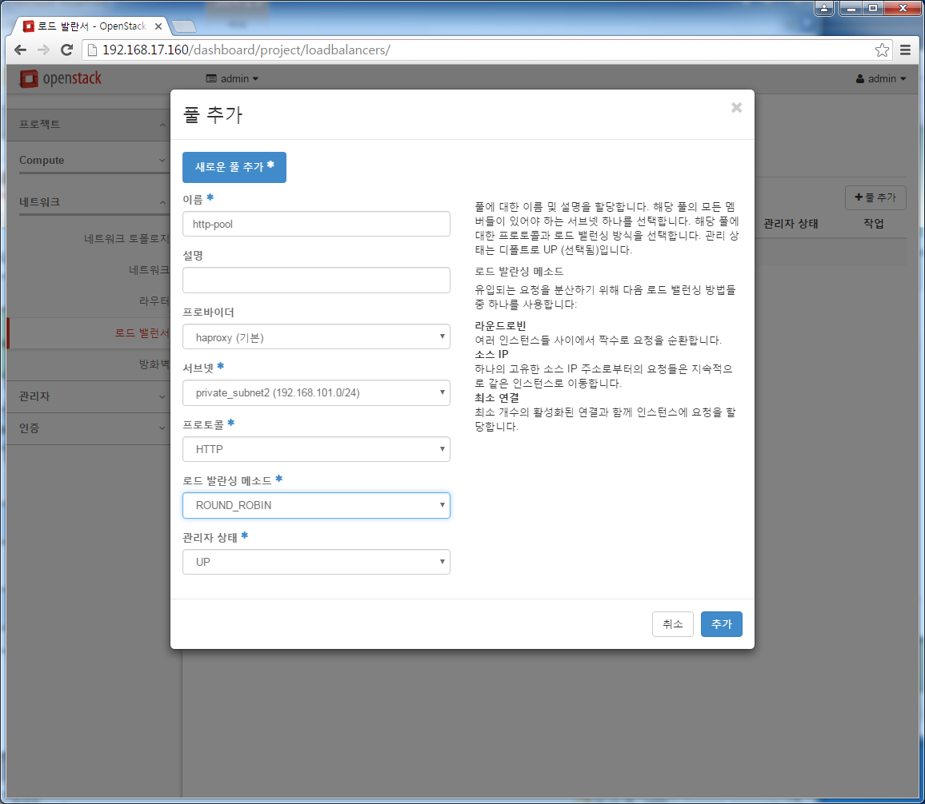
6. lbaas 설정
풀추가-> 풀멤버추가->VIP추가->VIP에 Floation IP할당->모니터추가->모니터풀에 연결
1. 새로운 pool 추가 (neutron lb-pool-create)

Slide 33
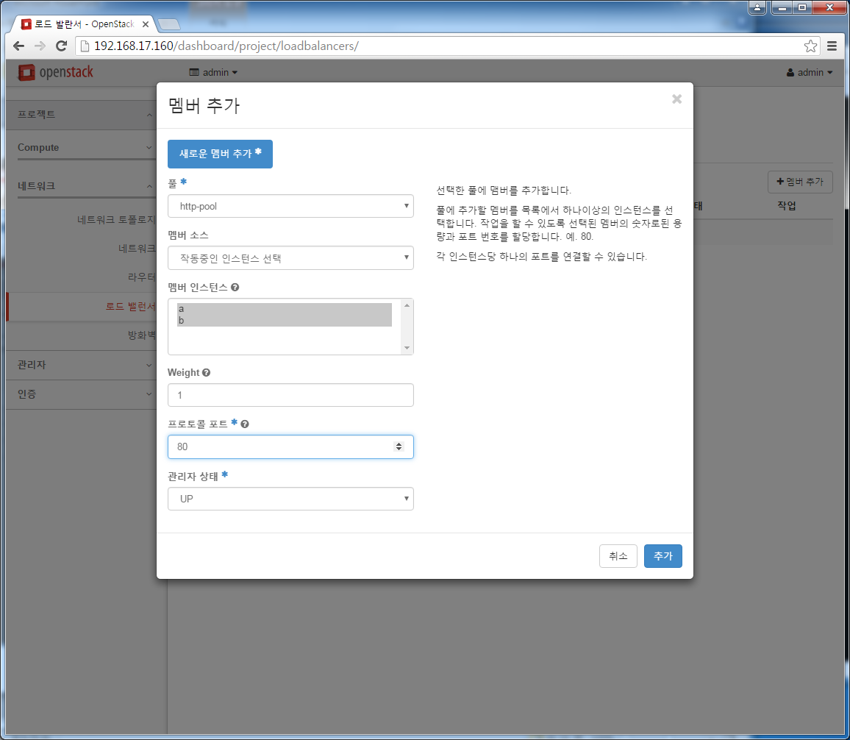
6. lbaas 설정
1. 풀에 새로운 멤버 추가(neutron lb-member-create)

Slide 34
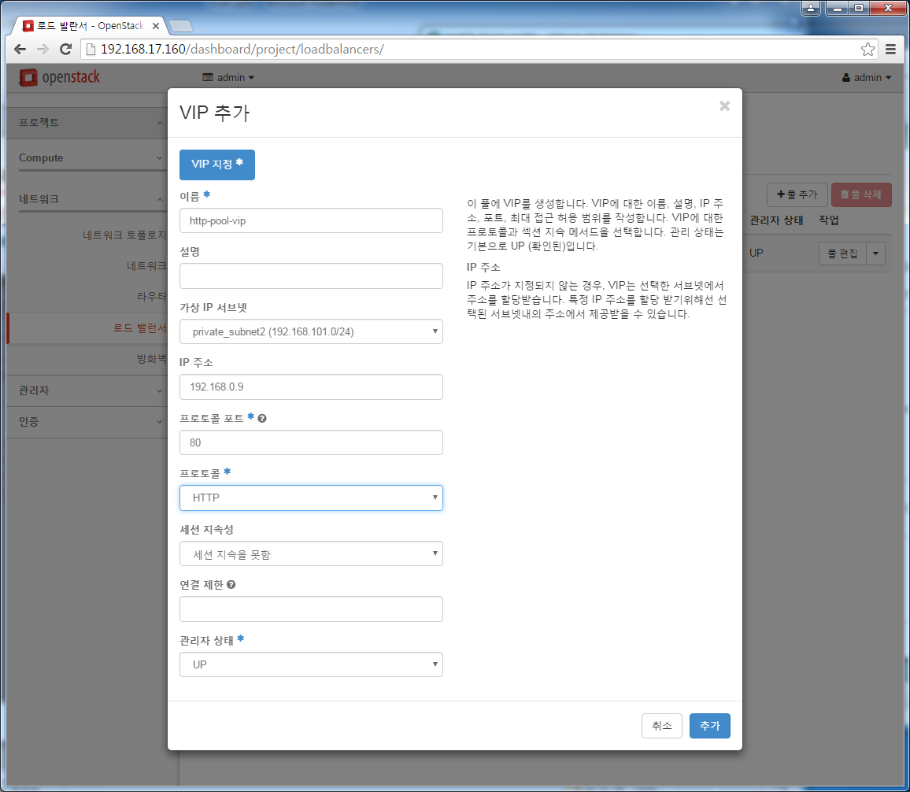
6. lbaas 설정
1. 풀에 VIP 추가(neutron vip-create)

Slide 35
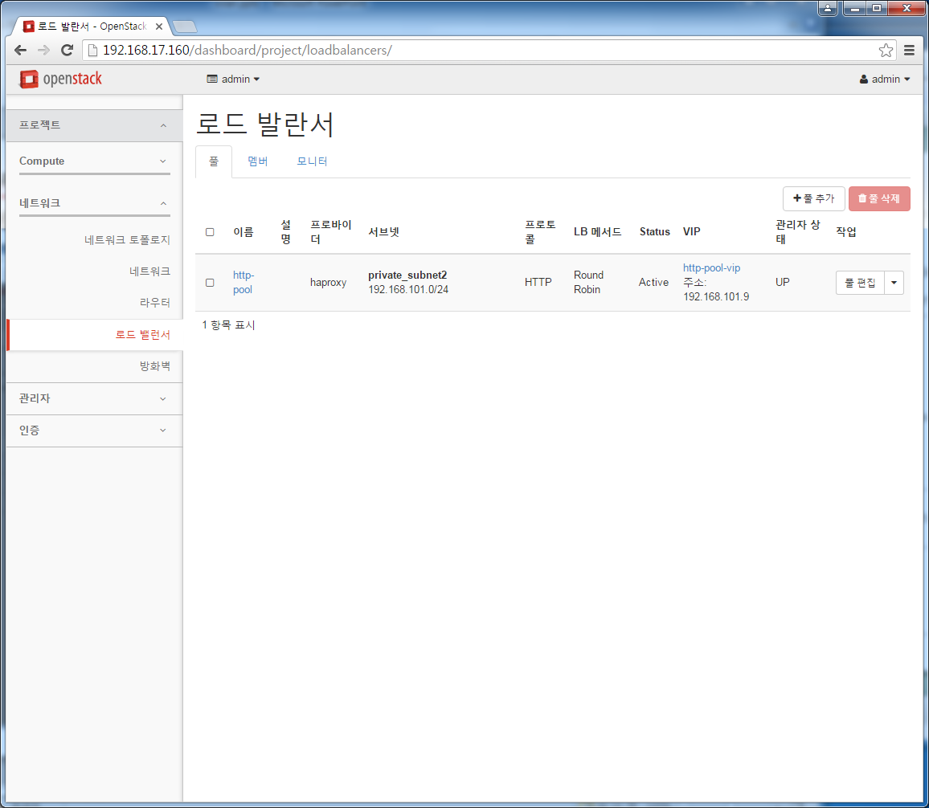
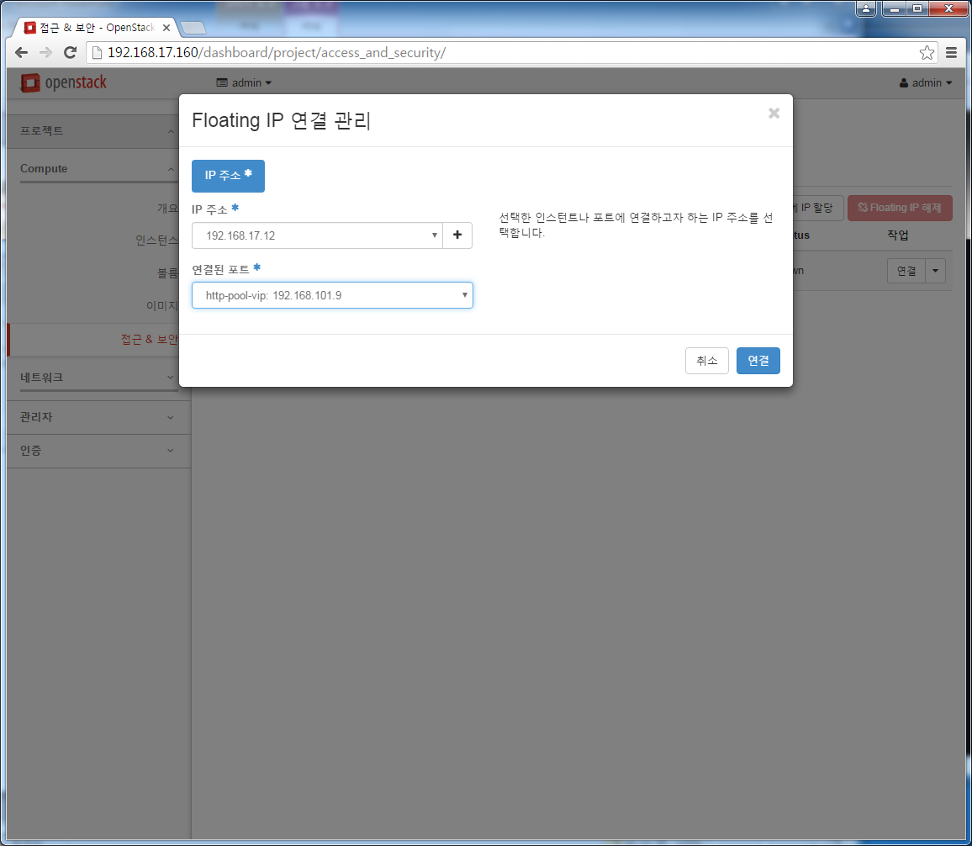
6. lbaas 설정
1. 풀에 VIP 추가된 상태
2. VIP에 Floating IP 연결 (neutron floatingip-associate)

Slide 36
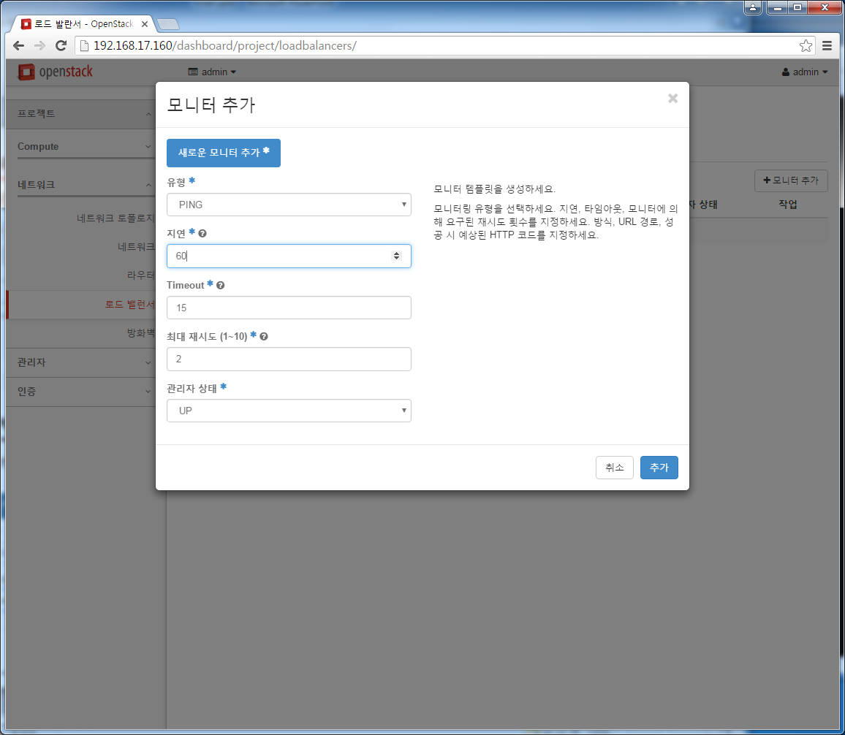
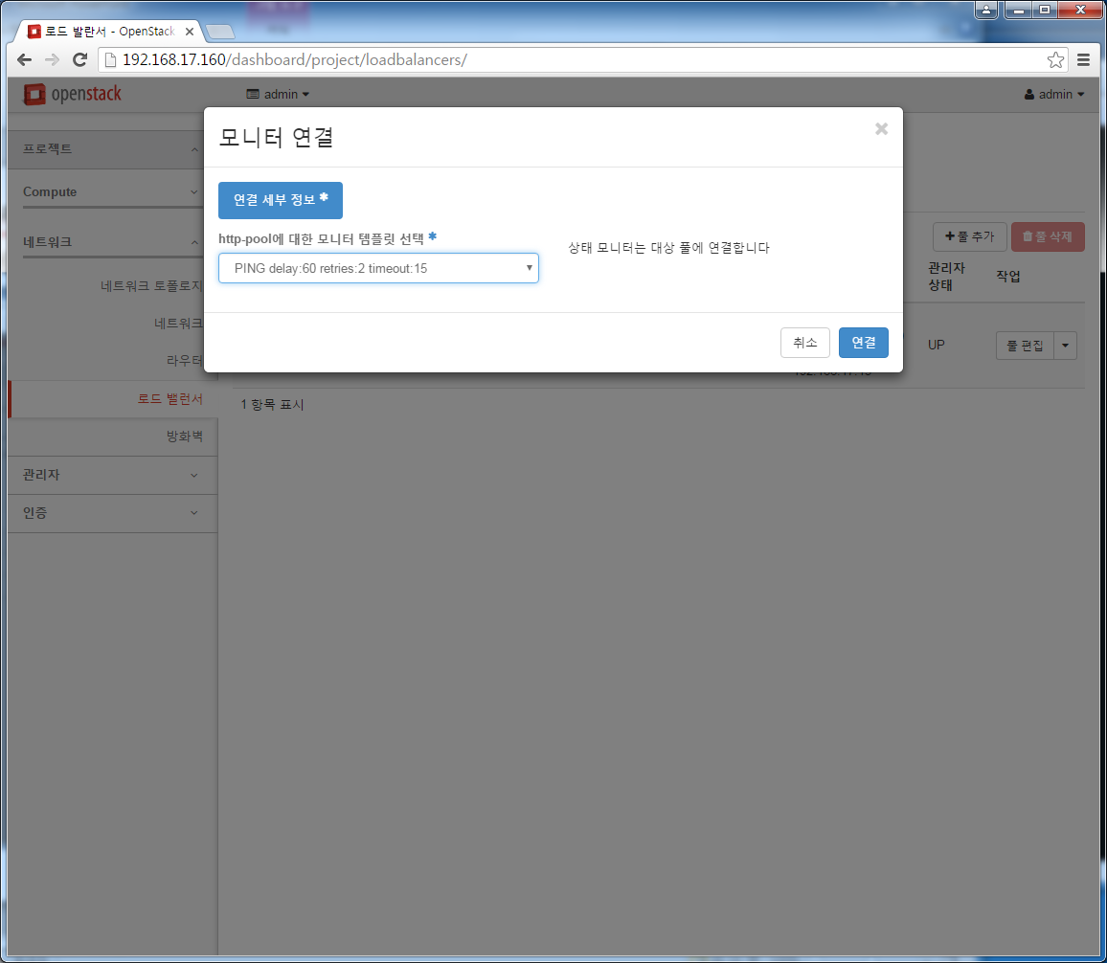
6. lbaas 설정
1. 모니터 추가(neutron lb-healthmonitor-create)
2. 풀에 모니터 연결하여 감시(neutron lb-healthmonitor-associate)

Slide 37
6. lbaas 설정
1. qlbaas 네임스페이스가 생성되며 네임스페이스 내에 VIP를 가지는 tap 디바이스가 생성
[root@localhost conf.d(keystone_admin)]# ip netns
qlbaas-428576a6-b078-4797-91ab-1a89d0ec4653
qdhcp-afaebfaf-8d8c-4f14-9546-a9b5ad173fe8
qrouter-1b348608-06a4-4038-b4b2-e13d144a761a
qdhcp-a05ecf62-298b-4938-be3d-d1f008e01667
qrouter-bb933656-3c3b-4e7a-8c63-5e16ed4674f1
[root@localhost conf.d(keystone_admin)]# ip netns exec qlbaas-428576a6-b078-4797-91ab-1a89d0ec4653 ip a
1: lo: <LOOPBACK,UP,LOWER_UP> mtu 65536 qdisc noqueue state UNKNOWN
link/loopback 00:00:00:00:00:00 brd 00:00:00:00:00:00
inet 127.0.0.1/8 scope host lo
valid_lft forever preferred_lft forever
inet6 ::1/128 scope host
valid_lft forever preferred_lft forever
51: tapaeaa0c32-15: <BROADCAST,MULTICAST,UP,LOWER_UP> mtu 1450 qdisc noqueue state UNKNOWN
link/ether fa:16:3e:2d:02:41 brd ff:ff:ff:ff:ff:ff
inet 192.168.101.9/24 brd 192.168.101.255 scope global tapaeaa0c32-15
valid_lft forever preferred_lft forever
inet6 fe80::f816:3eff:fe2d:241/64 scope link
valid_lft forever preferred_lft forever
[root@localhost conf.d(keystone_admin)]# netstat -anpl
Active Internet connections (servers and established)
Proto Recv-Q Send-Q Local Address Foreign Address State PID/Program name
tcp 0 0 192.168.101.9:80 0.0.0.0:* LISTEN 86586/haproxy
Active UNIX domain sockets (servers and established)
Proto RefCnt Flags Type State I-Node PID/Program name Path
unix 2 [ ACC ] STREAM LISTENING 1407012 86586/haproxy /var/lib/neutron/lbaas/428576a6-b078-4797-91ab-1a89d0ec4653/sock.86585.tmp
unix 2 [ ] DGRAM 1407014 86586/haproxy

Slide 38
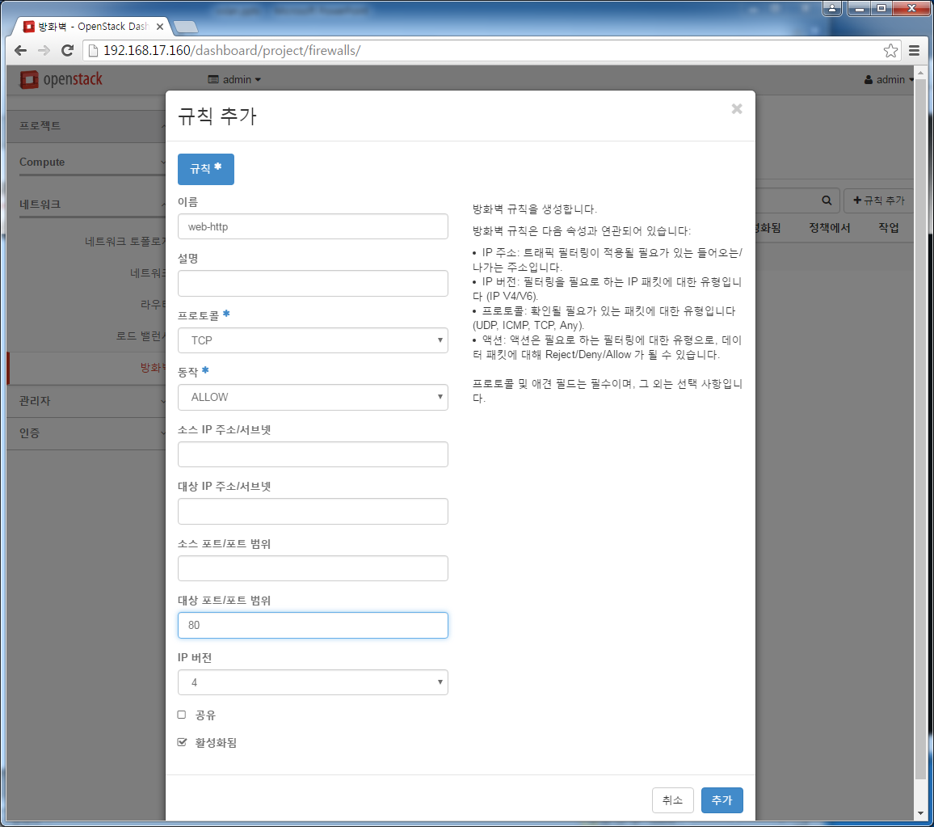
7. fwaas 설정
방화벽 규칙추가->방화벽 정책에 규칙추가->방화벽에 정책추가->방화벽에 라우터연결
1. 방화벽 규칙추가

Slide 39
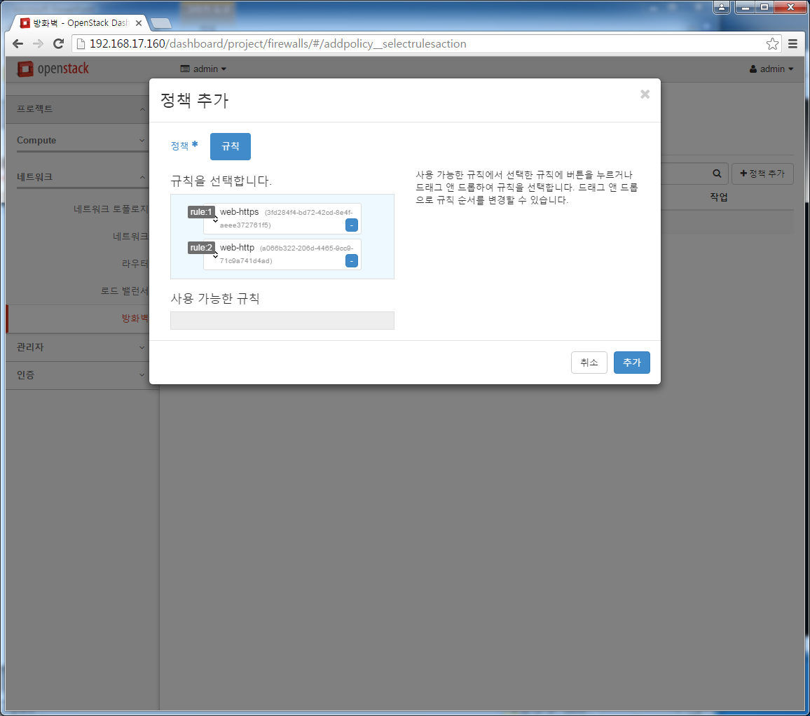
7. fwaas 설정
1. 방화벽 정책추가

Slide 40
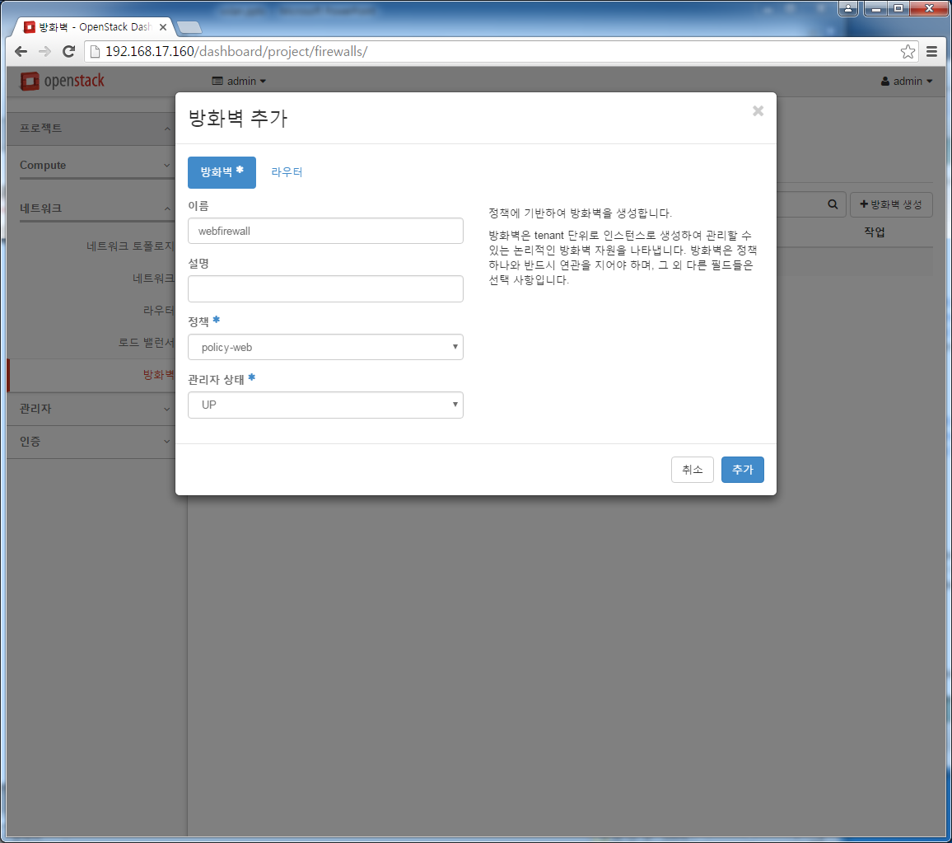
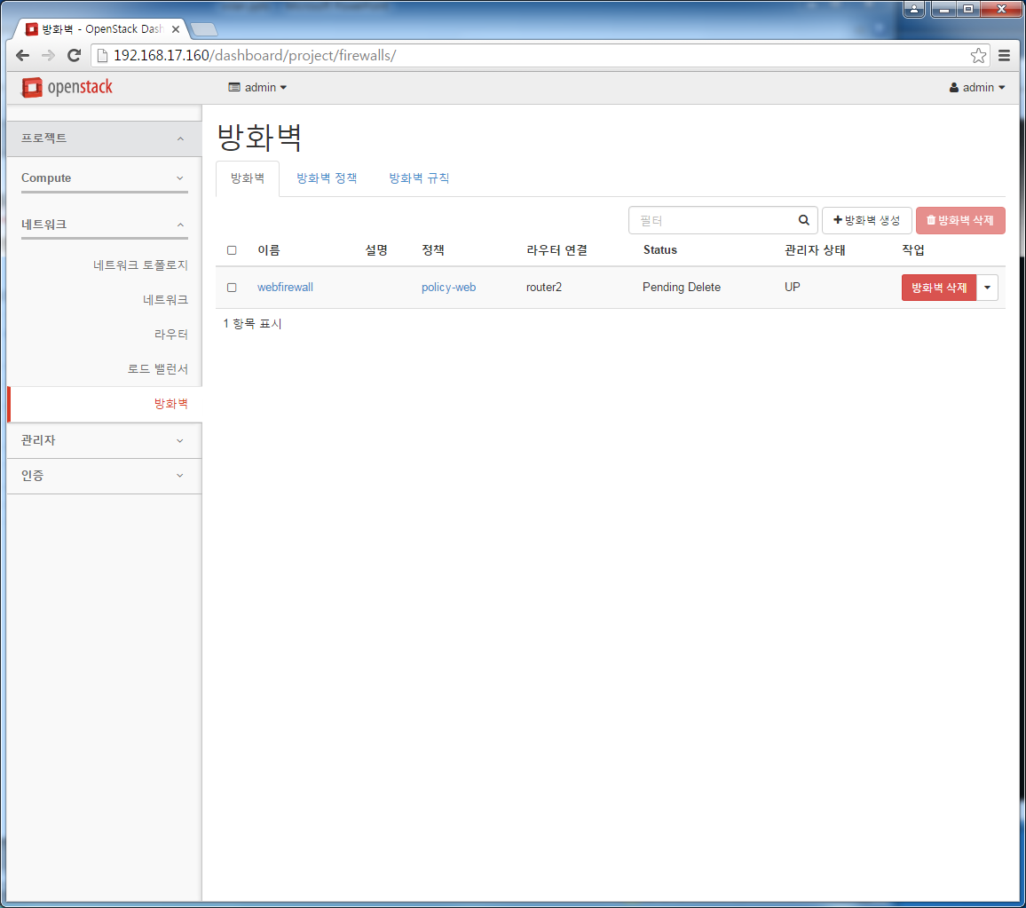
7. fwaas 설정
1. 방화벽 추가
2. 방화벽에 라우터 추가 정상이면 Active상태
방화벽에 라우터추가

Slide 41
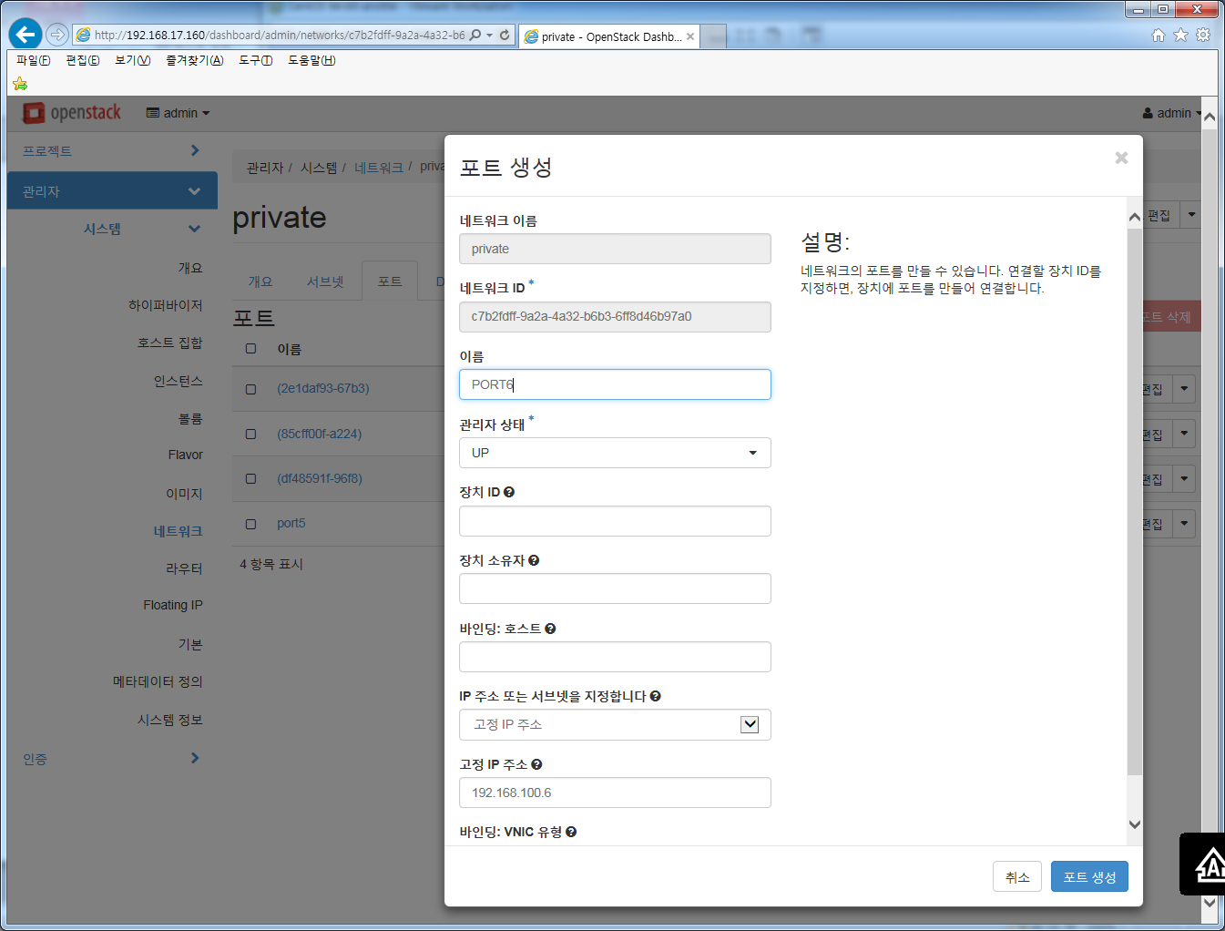
8. 고정IP 설정
1. 관리자->네트워크->포트->포트생성
고정IP 주소 설정
장치 연결: 연결 해제됨
STATUS: DOWN

Slide 42
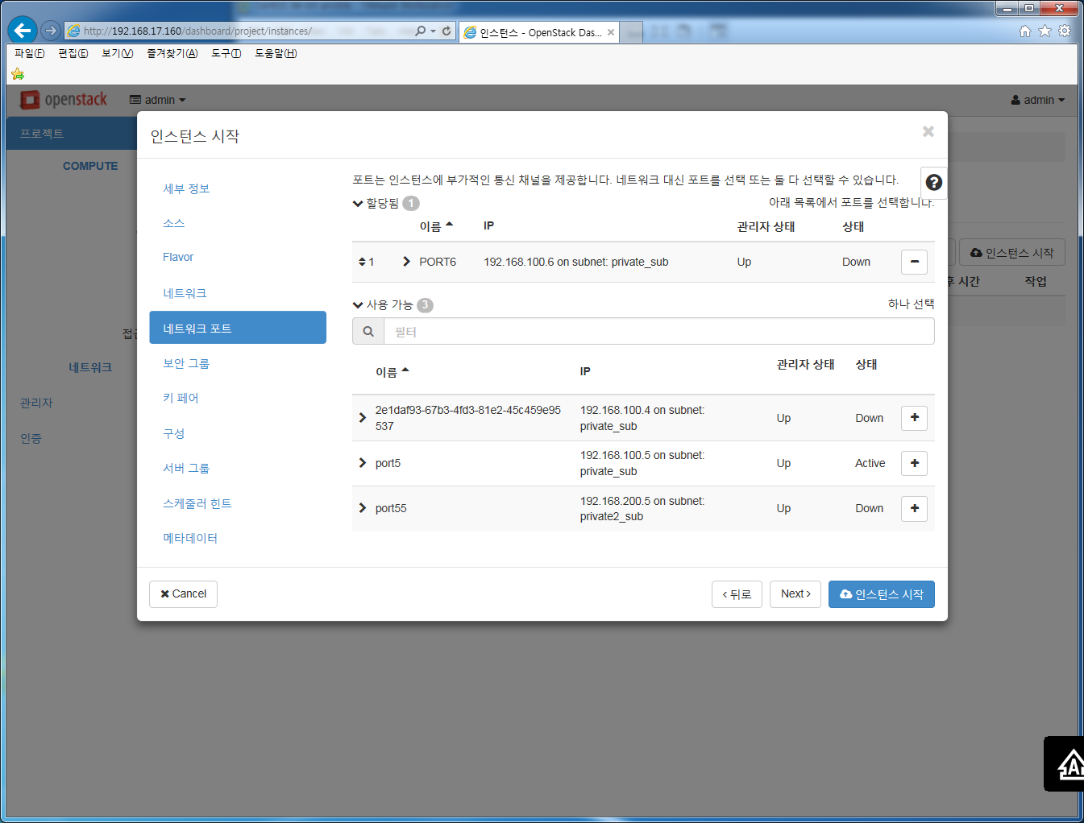
8. 고정IP 설정
1. 인스턴스 생성에서 네트워크 대신 미리 생성한 네트워크 포트 선택
미리 생성한 네트워크 포트선택

